Slide 1
Blockchain 101 for SOCAR Malaysia

Slide 2
What is Blockchain
A blockchain is a continuously growing data record blocks cryptographically connected to each other. All blocks are connected to their predecessors using a hash pointer, a timestamp, and transaction data. In other words, a blockchain is a distributed ledger managed by a peer to peer network whose nodes adhere to a predefined protocol.

Slide 3
History of Blockchain
Blockchain was first implemented by an anonymous cryptographer Satoshi Nakamoto in 2008 to implement a peer to peer payment system and cryptocurrency known as Bitcoin. Bitcoin achieved a fully decentralized payment system that does not require any regulatory bodies, third parties, or government bodies. Bitcoin allows anonymous customer to customer payment and financial transactions. Bitcoin Price is controlled by an in-built algorithm that statistically computes the market value based on supply and demand.

Slide 4
Types of Blockchains
Public Blockchains – by design they are designed to have no restrictions therefore anyone with internet access can send or validate so long as they follow the predefined rules by the consensus protocol.
Private Blockchains – These are permissioned networks, therefore, anyone that wishes to transact or validate transactions must be authorized by the network administrator.
Consortium blockchains- A consortium blockchain is often said to be semi-decentralized. It, too, is permissioned but instead of a single organization controlling it, a number of companies might each operate a node on such a network. The administrators of a consortium chain restrict users’ reading rights as they see fit and only allow a limited set of trusted nodes to execute a consensus protocol

Slide 5
Ethereum
In 2013,Vitalik Buterin noted that there was a huge fault in the Bitcoin Blockchain since it was not easy to program or implement in other fields apart from the financial industry. He therefore engineered a more usable an programmable blockchain platform that allows developers and companies implement Decentralized applications, smart contracts, Decentralized Autonomous Organizations and Blockchain Payment Systems. Ethereum enables companies and developers to build self managed systems like voting systems, auditing systems, ICOs, P2P systems and autonomous organizations powered by smart contracts.

Slide 6
Blockchain Uses
Land Registration
National Currencies
Smart contracts
Voting Systems
Education Systems
Financial systems
Dapps
DAOs

Slide 7
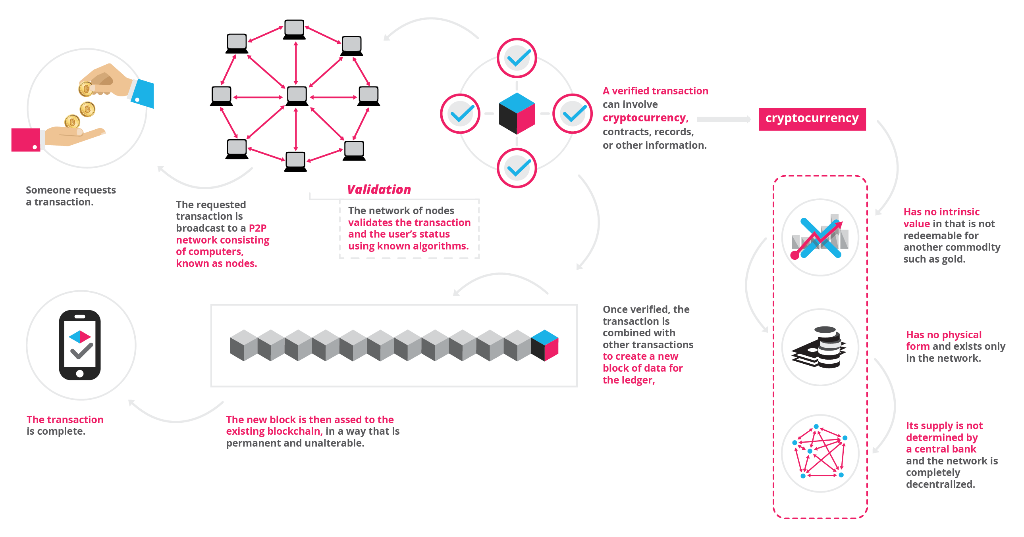
Distributed Applications(Dapps)

Slide 8
Dapps
Dapps may defined as decentralized applications that run on virtual machines and don’t require control from a third party. Typically, they manage themselves.
Open Source. Ideally, it should be governed by autonomy and all changes must be decided by the consensus, or a majority, of its users. Its code base should be available for scrutiny.
Decentralized. All records of the application’s operation must be stored on a public and decentralized blockchain to avoid pitfalls of centralization.
Incentivized. Validators of the blockchain should be incentivized by rewarding them accordingly with cryptographic tokens.
Protocol. The application community must agree on a cryptographic algorithm to show proof of value. For example, Bitcoin uses Proof of Work (PoW) and Ethereum is currently using PoW with plans for a hybrid PoW/Proof of Stake (PoS)5 in the future.
If we adhere to the above definition, the first Dapp was in fact Bitcoin itself. Bitcoin is an implemented blockchain solution that arose from problems revolving around centralization and censorship. One can say Bitcoin is a self-sustaining public ledger that allows efficient transactions without intermediaries and centralized authorities.

Slide 9
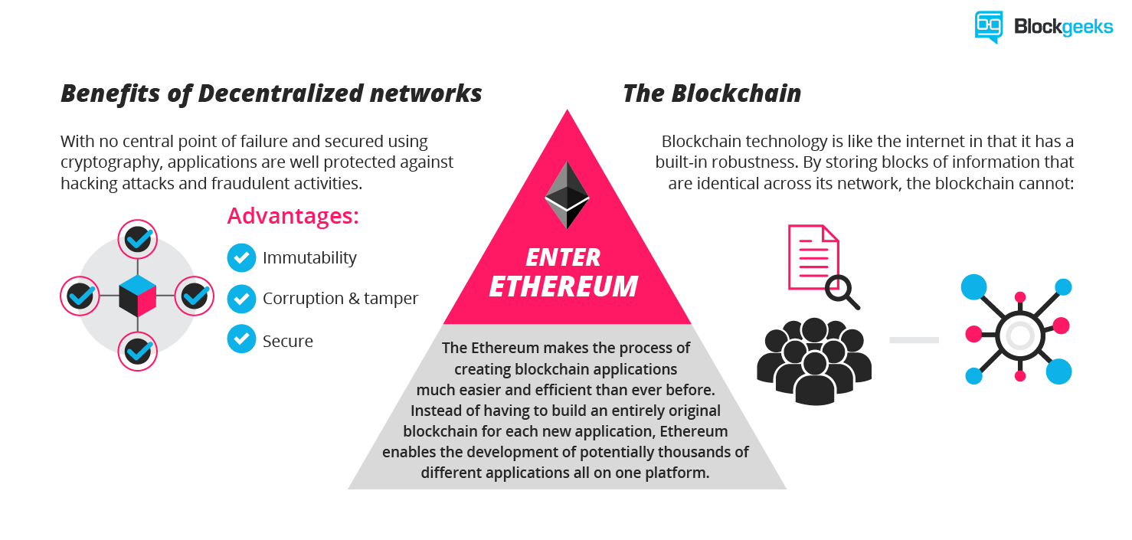
Dapps

Slide 10
Smart Contracts
They are contracts that can be partially or fully executed or enforced without human interaction.
Smart Contract Platforms:
Ethereum
Cardano
EOS

Slide 11
How to build a Smart Contract In Ethereum
Environment Set Up.
Install Ethereum Tools
Install Geth
Install Metamask
Install Node Js
Install Web3
Install Parity
Install Python
Install Truffle Js
Install Express Js.
Get a test node from Infura.io
Install VsCode Editor
Learn Solidity

Slide 12
Web3
What is web3?
Web3 is an API based technology that enables programmers communicate with the Ethereum blockchain using either JavaScript or Python programming languages.
web3 in Javascript
The web3.js object is an umbrella package to house all ethereum related modules.
var Web3 = require('web3');
> Web3.utils
> Web3.version
> Web3.modules

Slide 13
Smart Contract application in Ethereum
Steps to follow:
Install NodeJS in your system using your terminal or MSDOS platforms npm install nodejs
Declare your http provider
var Web3 = require('web3');
var web3 = new Web3('http://localhost:8545');
// or
var web3 = new Web3(new Web3.providers.HttpProvider('http://localhost:8545'));

Slide 14
Truffle Js
Install truffleJS smart contract development package
npm install -g truffle in NodeJs

Slide 15
Write your first smart contract in solidity
Create a folder for your smart Contracts on terminal or cmd
mkdir SmartContracts
cd SmartContracts
touch Samplecode.sol

Slide 16
Write your solidity code in the file
pragma solidity ^0.4.15;
contract Mortal {
/* Define variable owner of the type address */
address owner;
/* This function is executed at initialization and sets the owner of the contract */
function Mortal() { owner = msg.sender; }
/* Function to recover the funds on the contract */
function kill() { if (msg.sender == owner) selfdestruct(owner); }
}
contract Greeter is Mortal {
/* Define variable greeting of the type string */
string greeting;
/* This runs when the contract is executed */
function Greeter(string _greeting) public {
greeting = _greeting;
}
/* Main function */
function greet() constant returns (string) {
return greeting;
}
}

Slide 17
Test Your Smart Contract
Visit Remix Online Solidity Compiler:
https://remix.ethereum.org/
Paste the code in the editor and Start Debugging.
Refer to the READme.txt attached in the REPO.

Slide 18
END
Any Technical Assistance Questions or Clarifications?
Next Tutorial will be about Truffle and Ethereum Remix Smart Development
Enjoy!!!

